Slide 1
Chapter 4
SOFTWARE PROCESS AND PROJECT METRICS

Slide 2
Measures, Metrics, and Indicators are fundamental terms that form the basis for understanding software metrics. Here’s a breakdown of each term and how they relate:
1. Measures
A measure is a basic, raw count or quantity that provides a single data point. It’s a direct observation of a specific attribute.
For example, the number of lines of code (LOC), the number of defects found, or the total time spent on a project are all measures.
2. Metrics
Metrics are derived from measures and are often calculated by combining two or more measures. They provide more useful information than raw measures alone and help evaluate specific aspects of software development.
Examples include:
Defects per KLOC (Thousand Lines of Code): This is a metric that combines defect count (a measure) with code size (another measure).
Function Points (FP): Calculated based on a measure of functionality, such as the number of inputs, outputs, and file accesses.
3. Indicators
Indicators are interpretations or insights derived from metrics, often used to make strategic decisions or guide project management.
Indicators help managers make sense of data and guide corrective actions or improvements.

Slide 3
Software Metrics are measures used to assess software quality, productivity, and efficiency. Metrics help in planning, tracking, and improving processes and projects. They can be divided into:
Product Metrics: Focus on software quality (like size, reliability, and complexity).
Process Metrics: Measure efficiency and effectiveness of processes (such as defect rates, review effectiveness).
Project Metrics: Help track project progress (such as budget, timeline, resource usage).

Slide 4
Failure Analysis
In Failure Analysis, these six steps help organizations identify, understand, and address the root causes of software errors and defects. Here’s a breakdown of each step:
Step 1: Categorize Errors and Defects by Origin
All detected errors and defects are categorized based on their origin or root cause. Typical categories include:
Flaw in Specification: Issues caused by incorrect, incomplete, or misunderstood requirements.
Flaw in Logic: Problems stemming from design or code logic errors.
Nonconformance to Standards: Defects due to deviation from coding standards or best practices.
Categorizing errors helps teams identify patterns and areas where the development process might need improvement.
Step 2: Record the Cost to Correct Each Error and Defect
The cost to correct each error is documented, including time, resources, and financial impact.
Step 3: Count and Rank Errors and Defects by Category
After categorization, the number of errors and defects in each category is counted.
Categories are then ranked in descending order based on their frequency. This ranking helps teams focus on the most common problems.
Step 4: Compute the Overall Cost of Errors and Defects in Each Category
The total cost for each category of error or defect is calculated by summing up the individual correction costs.

Slide 5
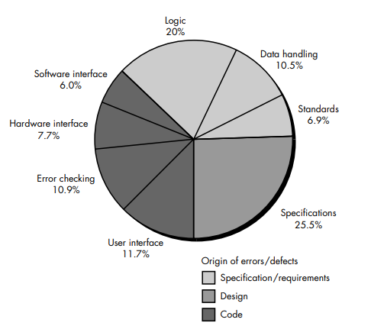
Step 5: Analyze Data to Identify High-Cost Categories
With the cost data organized, teams can analyze it to identify the categories that have the highest overall cost to the organization.
Step 6: Develop Plans to Modify the Process
Finally, teams develop plans to modify the development process to eliminate or reduce the frequency of costly errors.
By following these steps, organizations can make targeted improvements to reduce high-cost errors, leading to more efficient processes, higher-quality software, and reduced costs over time.

Slide 6
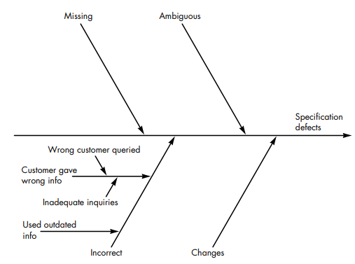
The pie-chart noted in the figure, eight causes of defects and their origin (indicated by shading) are shown.
Grady suggests the development of a fishbone diagram to help in diagnosing the data represented in the frequency diagram.
the spine of the diagram (the central line) represents the quality factor under consideration. Each of the ribs (diagonal lines) connecting to the spine indicate potential causes for the quality problem (e.g., missing requirements, ambiguous specification, incorrect requirements, changed requirements)

Slide 7
By collecting process metrics (data about how the software development process is performing), you can create a fishbone diagram. A fishbone diagram (also known as a cause-and-effect diagram) is a tool used to identify the possible causes of a problem.
Once the diagram is complete, it can be studied to find patterns or key reasons for errors and defects in the software. Using this information, the organization can make changes to its development process to reduce these errors and defects in the future. Essentially, it helps improve the overall quality of the software by addressing the root causes of problems.

Slide 8
Project Metrix
Project metrics are measurements or data collected during a software project to evaluate its performance, progress, and quality. These metrics help project managers and teams make informed decisions to improve efficiency, minimize risks, enhance quality, and control costs.
The intent of project metrics is twofold:-
First, these metrics are used to minimize the development schedule by making the adjustments necessary to avoid delays and mitigate potential problems and risks.
Second, project metrics are used to assess product quality on an ongoing basis and, when necessary, modify the technical approach to improve quality. As quality improves, defects are minimized, and as the defect count goes down, the amount of rework required during the project is also reduced. This leads to a reduction in overall project cost.
Another model of software project metrics suggests that every project should measure:
• Inputs—measures of the resources (e.g., people, environment) required to do the work.
• Outputs—These are the deliverables or work products produced during development, like code, documents, or prototypes.
• Results—measures that indicate the effectiveness or usefullness of the deliverables.

Slide 9
SOFTWARE MEASUREMENT
Measurements in the physical world can be categorized in two ways:
Direct measures (e.g., the length of a bolt) .
Indirect measures (e.g., the "quality" of bolts produced, measured by counting rejects).
Software metrics can be categorized similarly.
Direct measures of the software engineering process include cost and effort applied. Direct measures of the product include lines of code (LOC) produced, execution speed, memory size, and defects reported over some set period of time.
Indirect measures of the product include functionality, quality, complexity, efficiency, reliability, maintainability, and many other "–abilities"
The cost and effort required to build software, the number of lines of code produced, and other direct measures are relatively easy to collect, as long as specific conventions for measurement are established in advance.
However, the quality and functionality of software or its efficiency or maintainability are more difficult to assess and can be measured only indirectly.

Slide 10
Size-Oriented Metrics
Size-Oriented Metrics are a category of software metrics that focus on measuring the size of a software product to evaluate productivity, quality, and other attributes.
Some important measures are :-
Lines of Code (LOC):- The number of lines in the source code, excluding comments and blank lines.
KLOC (Thousand Lines of Code):- Used for larger projects.
Productivity:-Measures how much software a developer produces over time.(Productivity=Person-Months/LOC or KLOC)
Effort :- Person per month required.
Cost :- Cost per month required.
Documentation:-Pages of documentation were required.
Errors:-Errors were recorded before the software was released.
Defects:-Defects were encountered after release .
People:-People worked on the development of software.

Slide 11
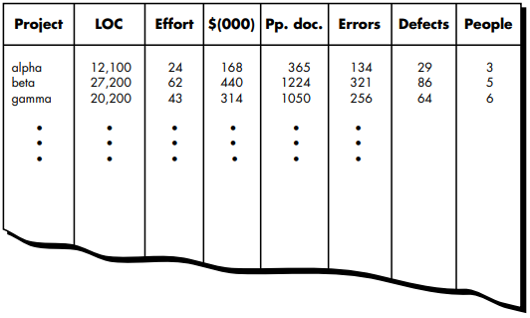
Based on the prevous measures we can create size oriented matrix for any project :-
for project alpha:-
12,100 lines of code were developed with 24 person-months of effort at a cost of $168,000. 365 pages of documentation were developed, 134 errors were recorded before the software was released, and 29 defects were encountered after release to the customer within the first year of operation. Three people worked on the development of software for project alpha.

Slide 12
Function-Oriented Metrics
Function-Oriented Metrics focus on measuring software based on its functionality rather than its physical size. These metrics evaluate the software's ability to meet user requirements by considering functions like inputs, outputs, and the complexity of operations.
Instead of measuring the size of the code, function-oriented metrics measure the amount of functionality provided to the user.
These are typically expressed in terms of Function Points (FP), a unit that quantifies the functionality delivered by the software.
Key Components in Function Point Analysis (FPA)
Function Points are calculated based on the following components:
1.Number of user inputs. :-
Data or control inputs provided by the user, such as forms or input fields.
Example: A login form where users enter credentials.
2.Number of user outputs:-
Information sent to the user, such as reports or error messages etc.
Example: A summary report generated by the system .

Slide 13
3.Number of user inquiries.:-
User-initiated interactions that involve a request for information and its response.
Example: A search operation in a database.
4.Number of files.:-
Files or data groups maintained by the system.
Example: A database storing customer details.
5.Number of external interfaces.:-
Files or data groups used by the system but maintained by external systems.
Example: A file shared with a third-party payment gateway.
Assign weights (simple, average, or complex) to each function type (UI, UO, UiQ, F, EF) based on their complexity.
Use a predefined table to determine the weights.
To compute function points (FP), the following relationship is used: FP = count total * [0.65 + 0.01 * ∑(Fi )]
where count total is the sum of all FP entries obtained from Figure given below. and
The Fi (i = 1 to 14) are "complexity adjustment values“.

Slide 14
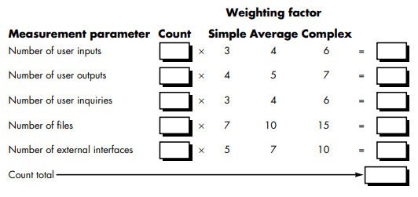

Slide 15
Extended Function Point Metrics
The function point measure was originally designed to be applied to business information systems applications. To accommodate these applications, the data dimension (the information domain values discussed previously) was emphasized to the exclusion of the functional and behavioral (control) dimensions. For this reason, the function point measure was inadequate for many engineering and embedded systems which emphasize function and control.
A number of extensions to the basic function point measure have been proposed to remedy this situation.
A function point extensions are called feature points and 3D Function Points , is a superset of the function point measure that can be applied to systems and engineering software applications.
The feature point measure accommodates applications in which algorithmic complexity is high.
Real-time, process control and embedded software applications tend to have high algorithmic complexity and are therefore amenable to the feature point.
To compute the feature point, information domain values are again counted and weighted as described for function point (inputs, outputs, files, inquiries, and external references).
In addition, the feature point metric counts a new software characteristic—algorithms.
An algorithm is defined as "a bounded computational problem that is included within a specific computer program” . Inverting a matrix, decoding a bit string, or handling an interrupt are all examples of algorithms

Slide 16
3D Function Points
Another function point extension for real-time systems and engineered products has been developed called 3D Function Points.
This approach integrates the data dimension of software with the functional and control dimensions to provide a function-oriented measure amenable to applications that emphasize function and control capabilities.
How Data , Functional and control dimensions are evaluated :-
Data Dimension:
Evaluated similarly to Function Points, using:
Retained Data: Number of files.
External Data: Inputs, outputs, inquiries, and external references.
Functional Dimension:
Measures internal operations needed to transform input to output.
Example: Transforming raw sensor data into a formatted display.
Control Dimension:
Counts transitions between states, where:
A state represents an externally observable mode of behavior.
A transition is triggered by an event causing the system to change states.
Example: In a wireless phone:
Resting State → User presses "Auto" → Auto Dial State
User enters number → Presses "Dial" → Dialing State

Slide 17
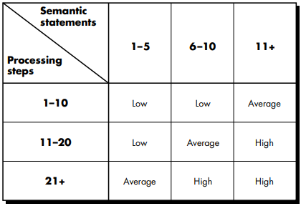
Formula for 3D Function Points:
Index = I + O + Q + F + E + T + R
where I, O, Q, F, E, T, and R represent complexity weighted values for the elements : inputs, outputs, inquiries, internal data structures, external files, transformation, and transitions, respectively.
I: Inputs
O: Outputs
Q: Inquiries
F: Files (retained data)
E: External references
T: Transitions
R: Internal operations required for data transformations
. Each complexity weighted value is computed using the following relationship:
complexity weighted value = NilWil + NiaWia + NihWih
where Nil, Nia, and Nih represent the number of occurrences of element i (e.g., outputs) for each level of complexity (low, average, high); and Wil, Wia, and Wih are the corresponding weights.
Figure :-Determining the complexity of a transformation for 3D function points

Slide 18
METRICS FOR SOFTWARE QUALITY
The goal of software engineering is to deliver high-quality systems, applications, or products. Quality metrics help measure how effective the development process is and ensure the final product meets user expectations. These metrics are used at various stages of the software lifecycle, from requirements to testing
Important Software Quality Metrics :-
1.Errors per Function Point:
Tracks the number of errors in work products (e.g., requirements, design) normalized by the functionality delivered.
2.Errors Uncovered per Review Hour:
Measures the number of errors found during peer reviews or inspections.
3.Errors Uncovered per Testing Hour:
Measures the number of errors found during testing activities.
4.Defect Removal Efficiency (DRE):
Indicates the effectiveness of error detection during different stages.
Formula: DRE=(Errors Found Before Delivery/Total Errors (Before + After Delivery))×100
A higher DRE indicates better error-detection processes.

Slide 19
Measuring Quality
Although there are many measures of software quality, correctness, maintainability, integrity, and usability provide useful indicators for the project team. Definiation of given below :-
1. Correctness
Definition: The degree to which software performs its required functions without errors.
Measurement:
Common metric: Defects per KLOC (thousand lines of code).
A defect is a verified failure to conform to requirements.
Defects are counted over a standard period, often one year after release.
Significance: A low defect count indicates higher correctness, reflecting well-implemented and tested software.
2. Maintainability
Definition: The ease with which a software program can be:
Corrected: Fix errors.
Adapted: Modify it for environmental changes.
Enhanced: Add new features or improve performance.
3. Integrity
Definition: A system's ability to resist and withstand attacks (intentional or accidental) on its security.
4. Usability
Definition: The ease and efficiency with which users can learn and use the software.

Slide 20
Defect Removal Efficiency
DRE measures how well the team identifies and removes errors before the software is delivered to the end-user or passed to the next phase of development.
Project-Level DRE: Measures the overall effectiveness of error removal before delivery.
When considered for a project as a whole, DRE is defined in the following manner:
DRE = E/(E + D)
where E is the number of errors found before delivery of the software to the end-user and D is the number of defects found after delivery.
The ideal value of DRE is 1 (all defects are found before delivery, so D=0).
Realistically, D>0, but a high DRE value indicates good QA/QC practices.
Activity-Level DRE: Focuses on the efficiency of specific lifecycle phases to assess how effectively errors are removed before being passed to the next activity.
DREi = Ei /(Ei + Ei+1)
where Ei is the number of errors found during software engineering activity i and Ei+1 is the number of errors found during software engineering activity i+1 that are traceable to errors that were not discovered in software engineering activity i.

